Slide 1
Intel S2600WTT BIOS Setting - GRRFSDP1.86B.0224.R00.1501230958 only
/------------------------------------------------------------------------------\
| Processor Configuration |
\------------------------------------------------------------------------------/
Lock Chipset <Disable>
MSR Lock Control <Disable>
/------------------------------------------------------------------------------\
| Memory Configuration |
\------------------------------------------------------------------------------/
Memory Frequency <1333>
MemTest <Disable>
Data Scrambling <Disabled>
/------------------------------------------------------------------------------\
| Memory Map |
\------------------------------------------------------------------------------/
Channel Interleaving <1-way Interleave>
Rank Interleaving <1-way Interleave>
/------------------------------------------------------------------------------\
| Memory Training |
\------------------------------------------------------------------------------/
RX Ctle Training <Disable>
Tx Eq Calibration <Disable>
iMode Training <Disable>
Advanced Clk Training <Disable>
CMD Normalization <Disable>
/------------------------------------------------------------------------------\
| CPU C State Control |
\------------------------------------------------------------------------------/
CPU C State <Disable>
/------------------------------------------------------------------------------\
| DRAM RAPL Configuration |
\------------------------------------------------------------------------------/
DRAM RAPL Baseline <Disable>

Slide 2
N0.C0.D0 – 16GB LRDIMM N0.C1.D0 – 0734 HVDIMM
======================================================================================
START_SOCKET_0_TABLE
BDX A0 - EP
======================================================================================
S| Channel 0 | Channel 1 | Channel 2 | Channel 3 |
======================================================================================
0| DIMM: Hynix | DIMM: 1603 | Not installed | Not installed |
| DRAM: Hynix | DRAM: Samsung | | |
| RCD: IDT | RCD: IDT | | |
| 16GB(4Gbx4 1H DR) | 8GB(4Gbx4 1H SR) | | |
| DDR4 LRDIMM R/C-B | DDR4 LRDIMM R/C-B | | |
| 2133 9-9-9 | 1867 10-10-10 | | |
| ww47 2014 | ww14 2016 | | |
|HMA42GL7MFR4N-TF |HV4-25082-1SDT2 | | |
|0x0000000000000000 |0x0000000000000000 | | |
| | | | |
--------------------------------------------------------------------------------------
1| Not installed | Not installed | Not installed | Not installed |
--------------------------------------------------------------------------------------
2| Not installed | Not installed | Not installed | Not installed |
--------------------------------------------------------------------------------------
STOP_SOCKET_0_TABLE
======================================================================================
======================================================================================
| Socket 0 | Socket 1 | Socket 2 | Socket 3 | System |
======================================================================================
Active Memory | 24GB | N/A | N/A | N/A | 24GB |
DDR Freq | | | | | DDR4-1333 |
Ch0 CL-RCD-RP-CMD | 9-9-9-1n | | | | |
Ch1 CL-RCD-RP-CMD |11-10-10-1n | | | | |
DDR Vdd | | | | | 1.20V |
ECC Checking | | | | | On |
CAP Checking | | | | | On |
Patrol/Demand Scrub | | | | | Off/Off |
RAS Mode | | | | | Indep |
Xover Mode | | | | | 1:1 |
Paging Policy | | | | | Adapt Open |
Data Scrambling | | | | | Off |
======================================================================================

Slide 3
Intel S2600WTT – Broadwell-EP based platform
Test Platform Ip address: 10.5.3.187
Grub2.cfg: memmap = 8G\$18G
Login as root/password
Intel-S2600WTT-1: cd /home/lab/work/HV_trn_3-30pm-16
Source code: hv_training.c –o hvt, or –o hvt5(FPGA_1 Only)
How to start
root@Intel-S2600WTT-1:/home/lab/work/HV_trn_3-30pm-16]# hvt, ex) hvt5 3 1 0
Scan DIMM
DIMM[0]
DIMM[3]
Input: Dimm# TrainingID(1:CMD/CK, 2:TX DQ-DQS) Update(0/1)
Input: Dimm# dti(5/7) addr data
Input: Dimm#

Slide 4
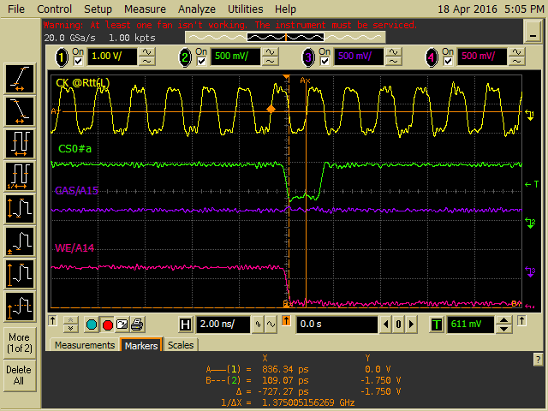
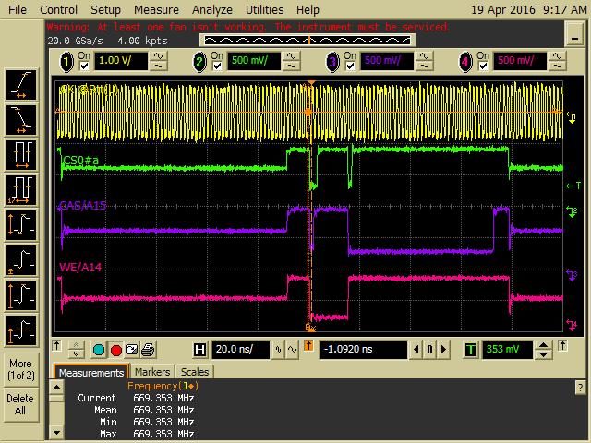
PostRCD Signals @1333, Intel S2600WTT(BDW)
-. CMD/CK training – FPGA sample CS0#a(FPGA1) and CS0#b(FPGA2)
-. Signals are captured @Rtt(Left side)
-. Post RCD signal level: Hi-Z, High, Low

Slide 5
S:\Departments\Engineering\HVDIMM\lab\DQ-DQS Training\hv_training.c
Need S/W updating;
Looping start from 0 to 255. However, 128 to 255(or 192) looks better.
find_cp_cs0() – find center point function
Current version: Last High to Low & Last Low to High( Passing point )
Need to revised:
Skip too small High/Low width Zone & find center point of LOW pulse width
Select 1’st finding value, if both low widths are same.
Expected Int. CLK Delay setting
Current Version

